Slide 1
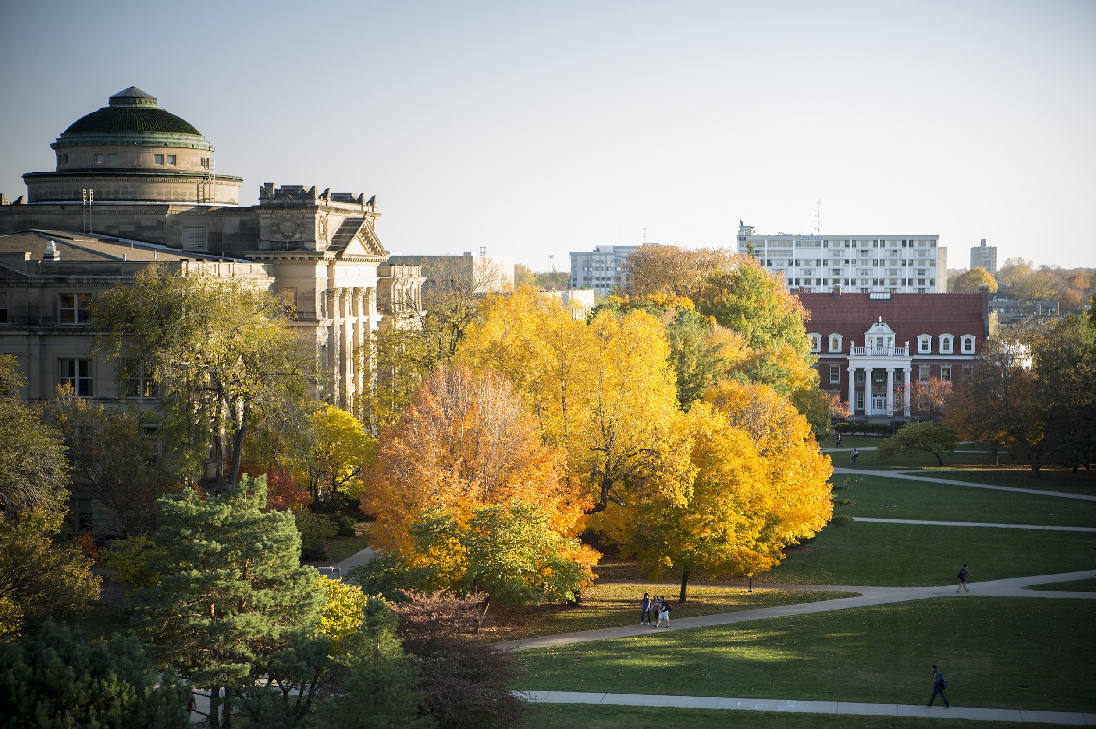
Department of Computer Science
COM S 573 FALL 2024

Slide 2

Diseased Plant Detection: A Comparative Study of CNN, VGG16, and ResNet Models
Ravi Shastri, Mohammed Musthafa Rafi, Sayan Das
Date: 12/12/2024
Course Name: Machine Learning COMS 573
Instructor Name: Prof. Mengdi Huai

Slide 3
Contents
Introduction
Problem Statement
Expected Outcomes
Dataset
CNN
VGG
ResNet50
CNN: Results
VGG: Results
ResNet50: Results
Decision Factor Index (DFI)
Conclusion

Slide 4



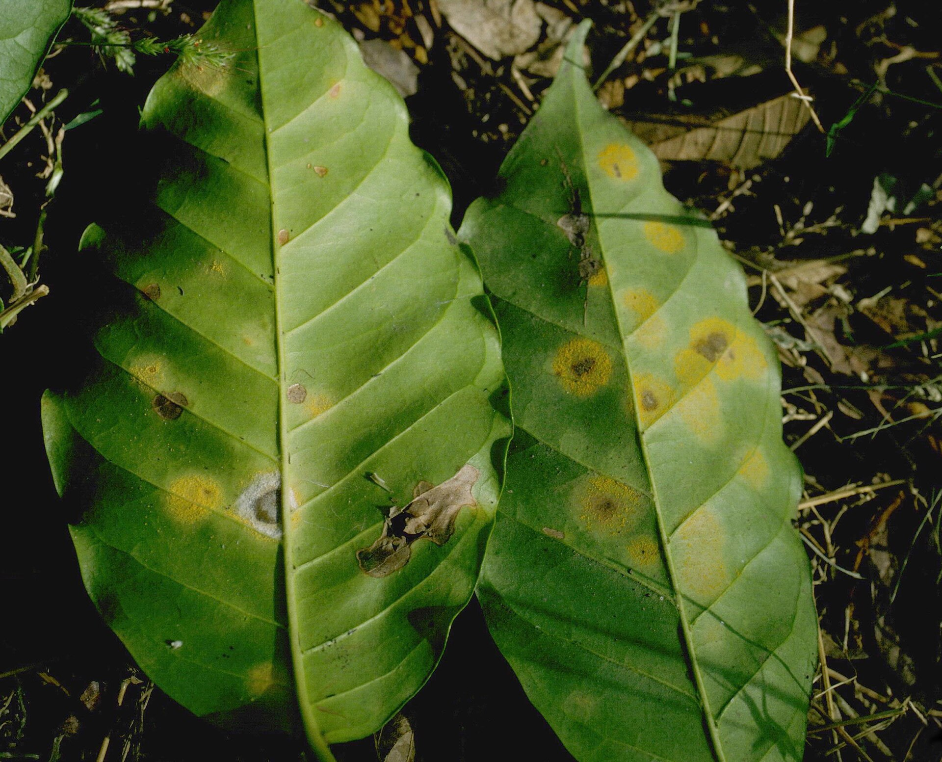
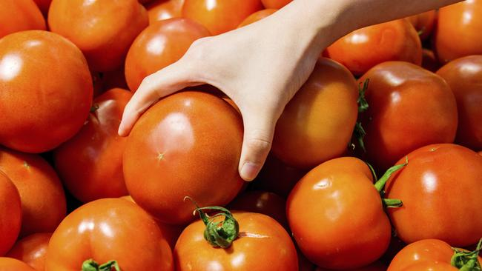
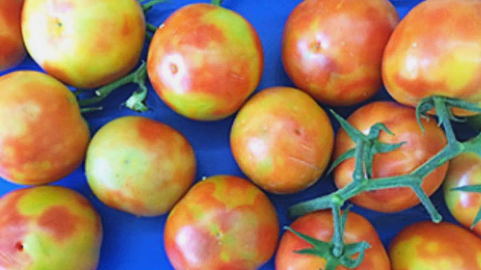


Introduction

Slide 5





Problem Statement
Figure 1: One sensor to rule them all

Slide 6
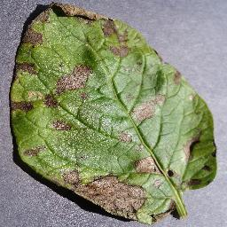
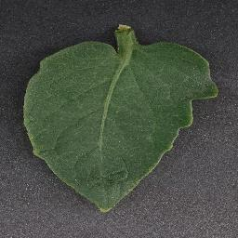


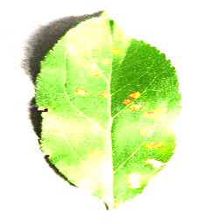

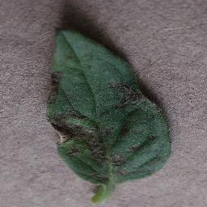
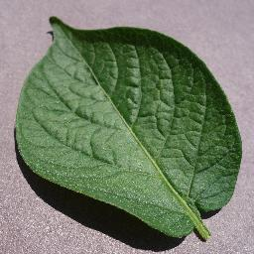
Expected Outcomes

Slide 7
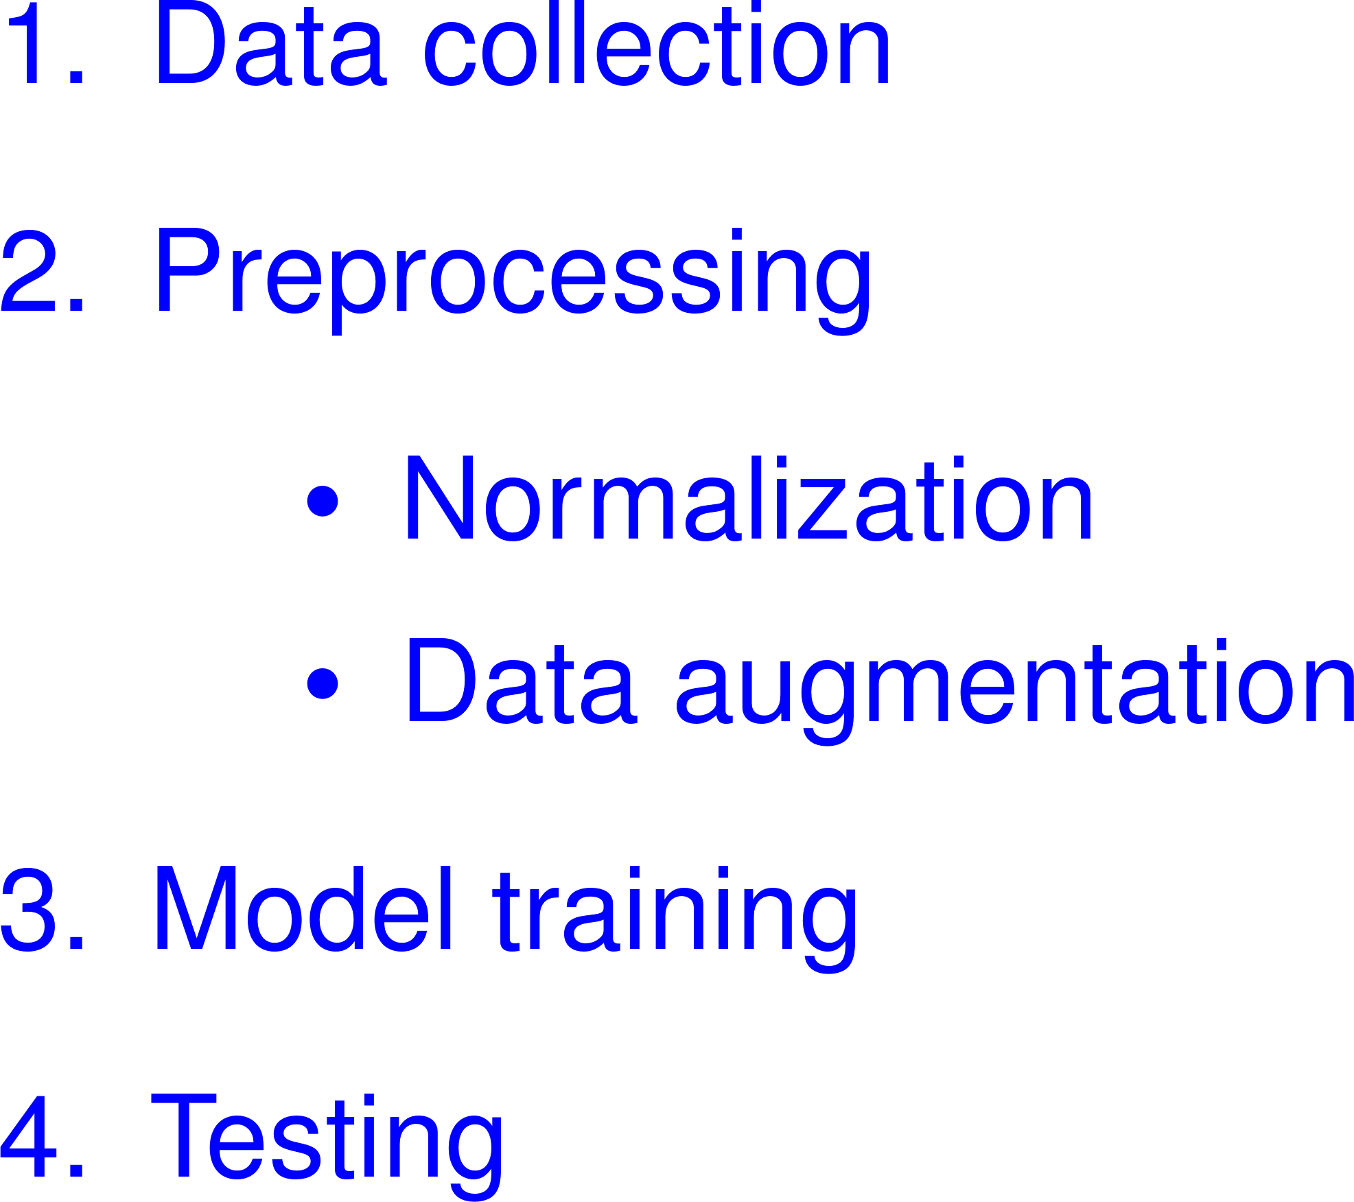
Datasets
What is the dataset?
Kaggle dataset
87363 images
70295 images for training
17068 images for testing

Slide 8
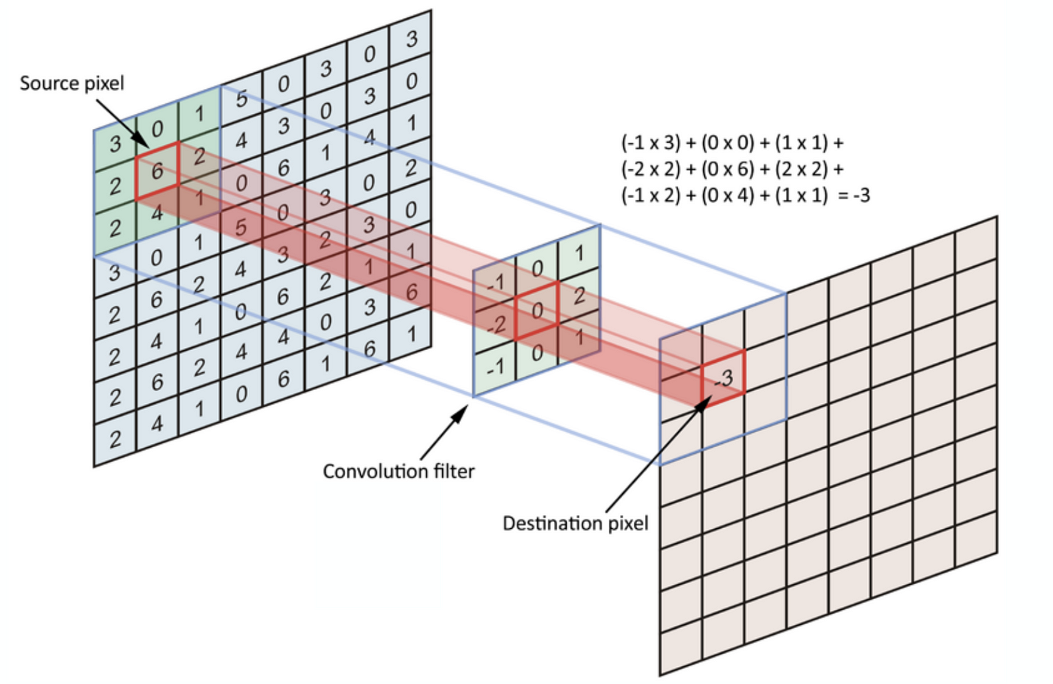

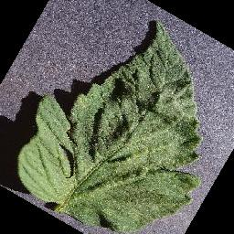
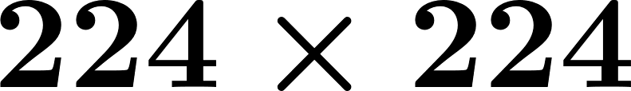

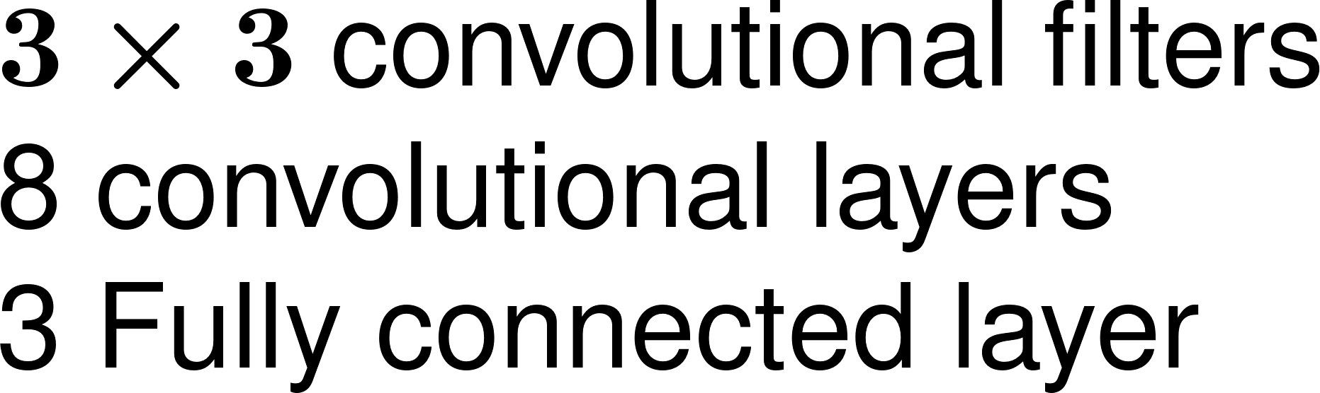


CNN: A Convolutional Neural Network Architecture

Slide 9

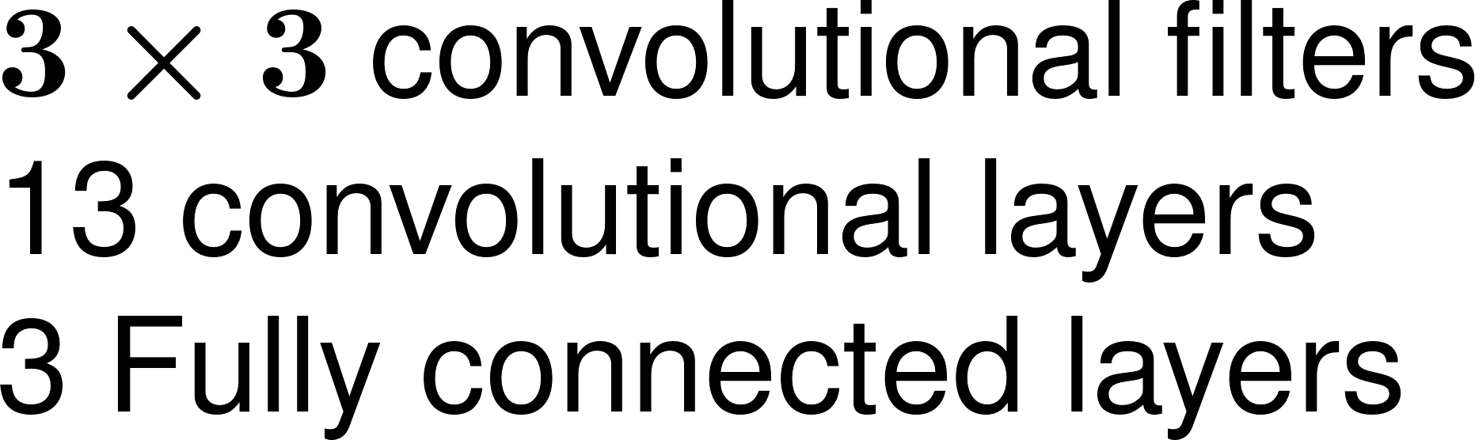
VGG16 : A Convolutional Neural Network Architecture

Slide 10
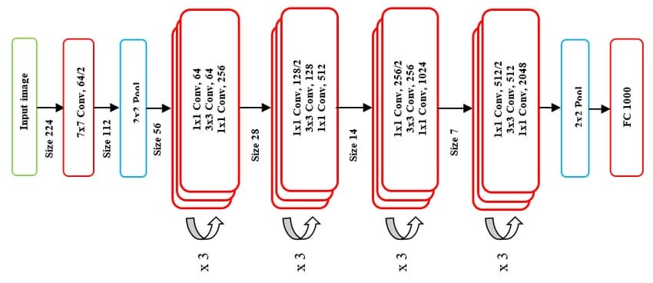
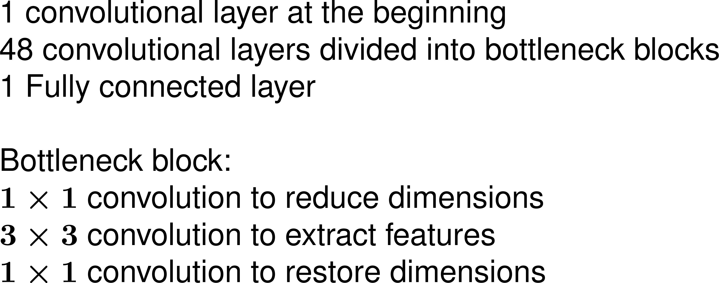
ResNet50

Slide 11
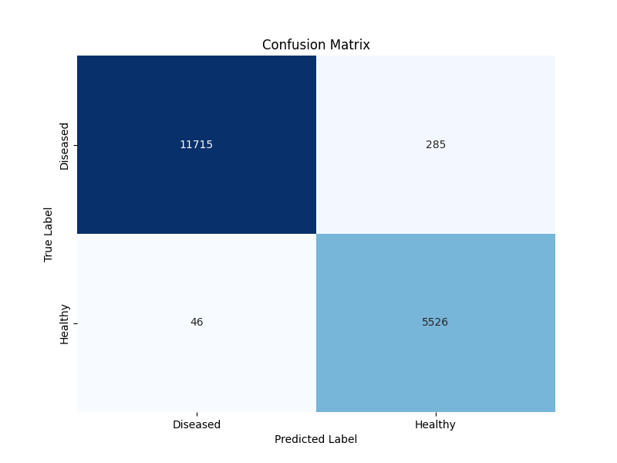
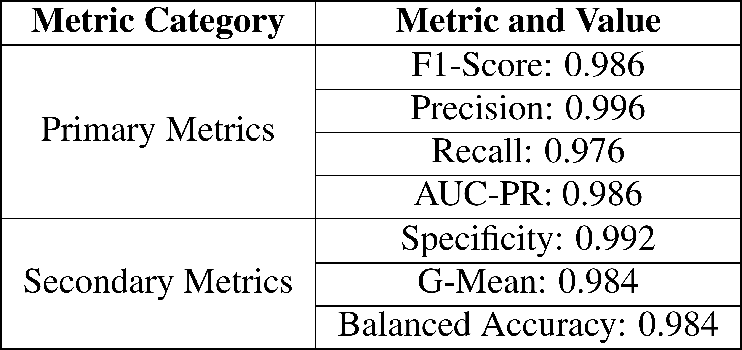
CNN: Results

Slide 12
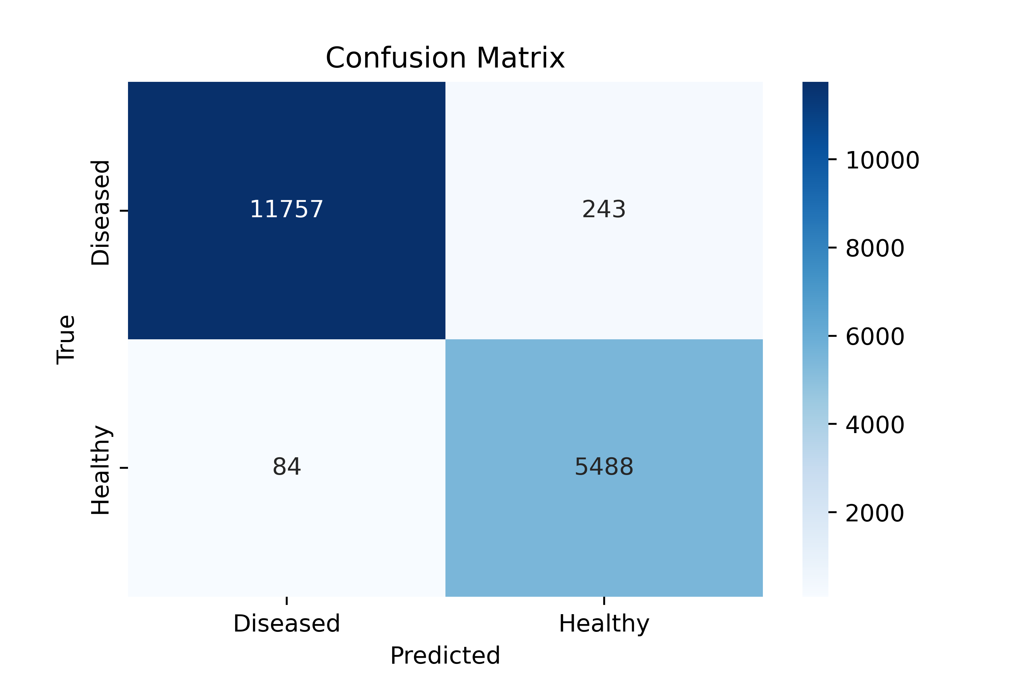
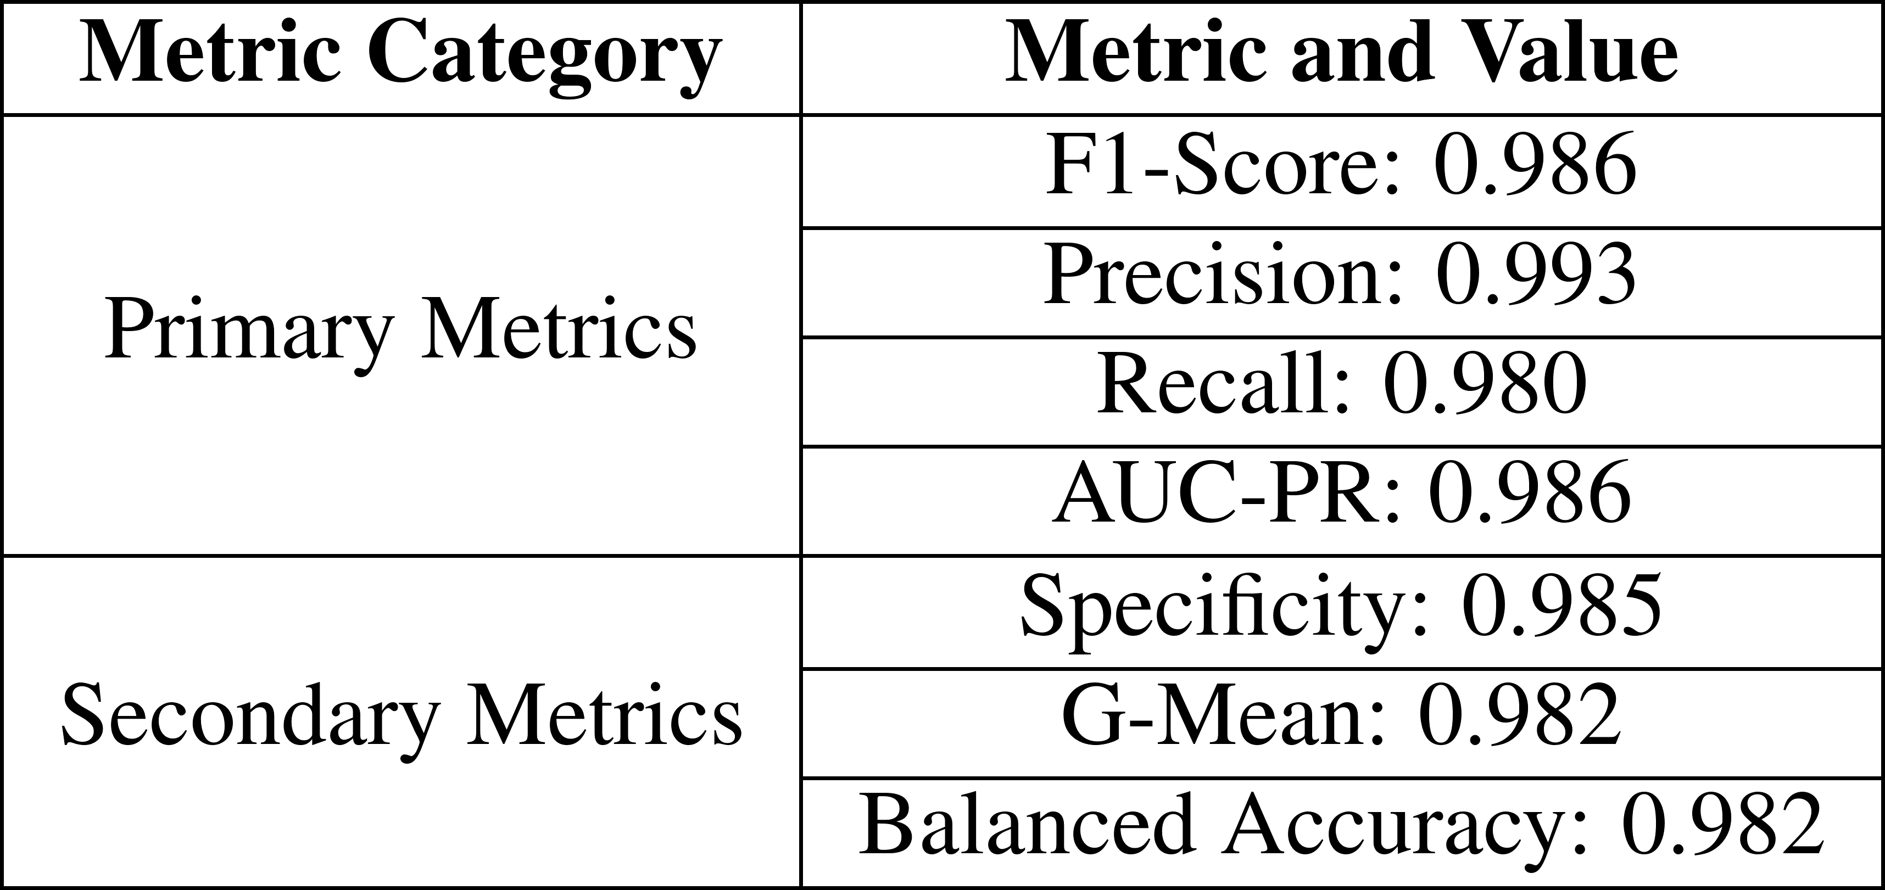
Results: VGG16

Slide 13
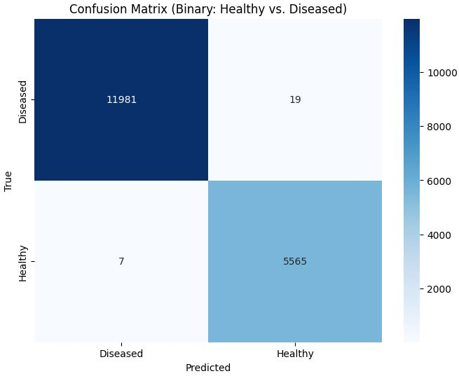

ResNet50: Results

Slide 14
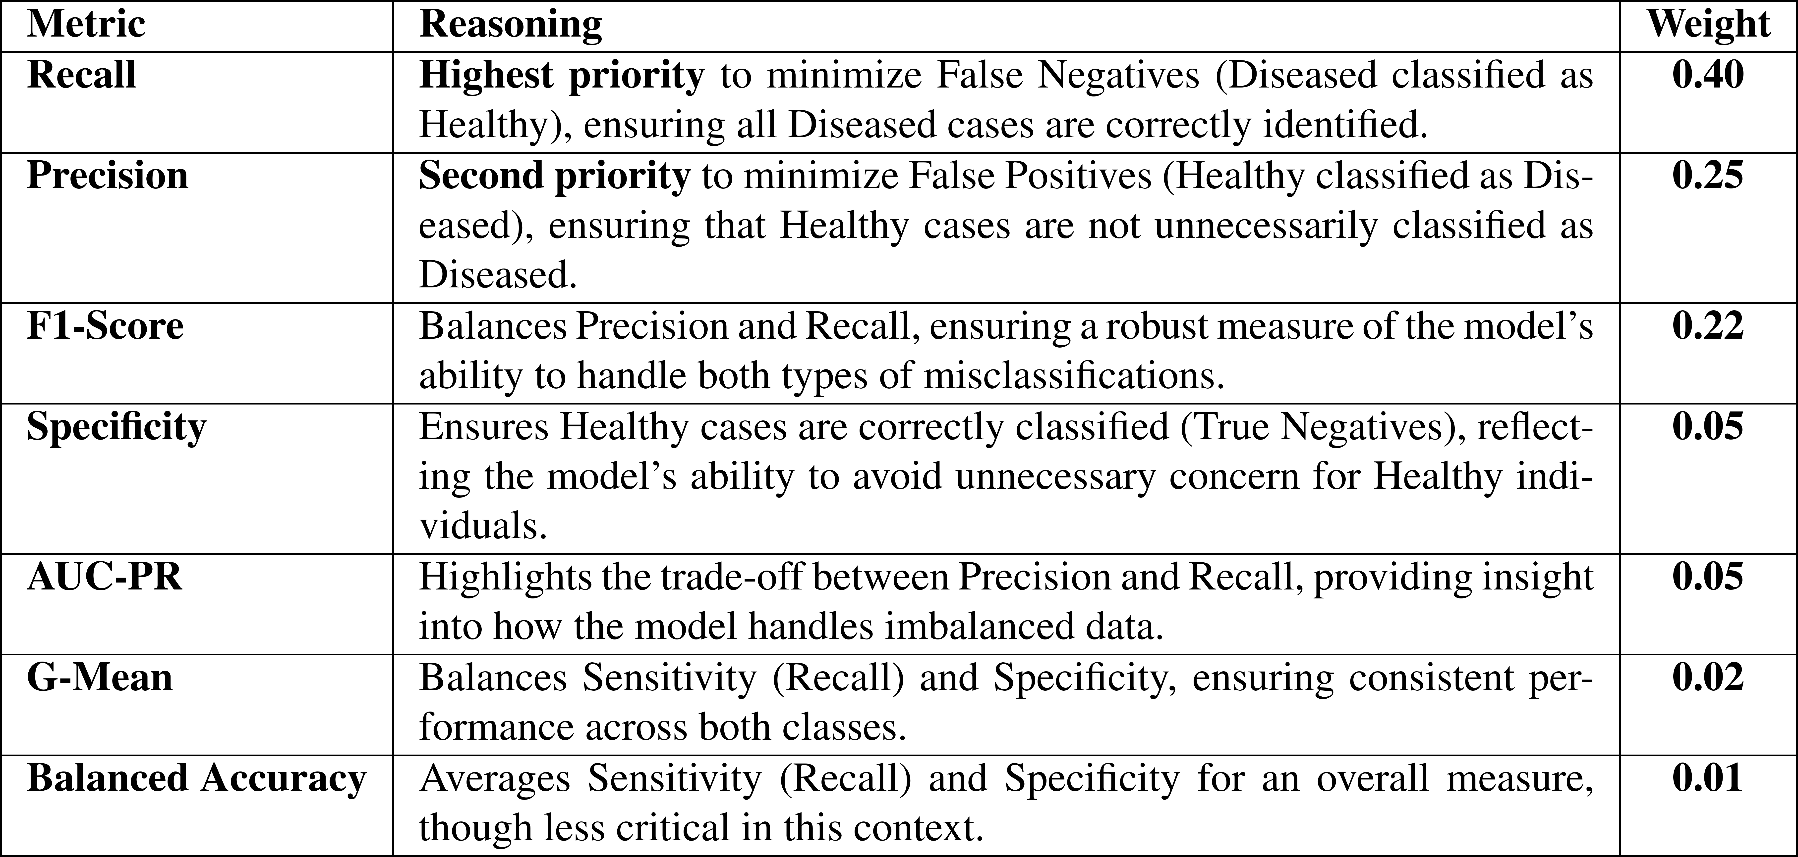
Decision Factor Index

Slide 15
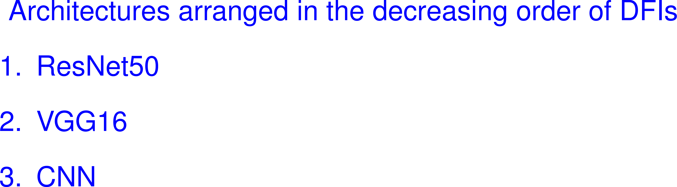

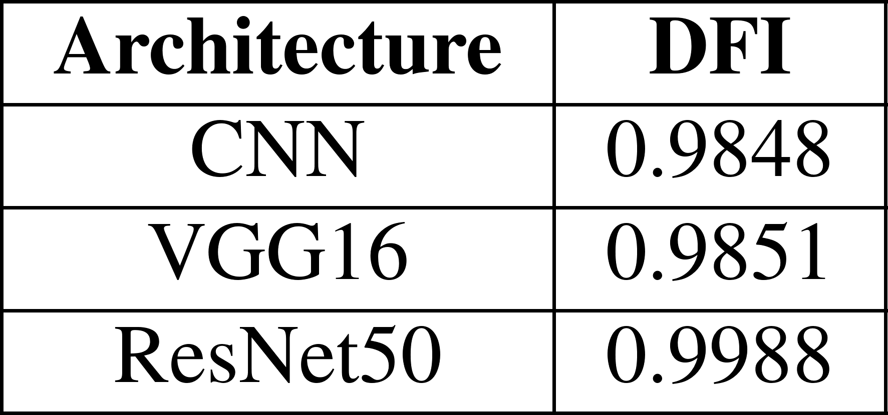
Conclusion

Slide 16
Thank you!

Slide 17
Questions?

